Slide 1

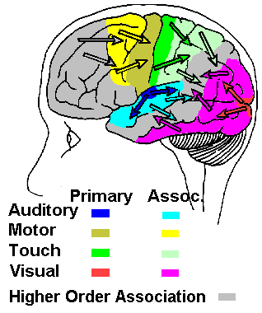
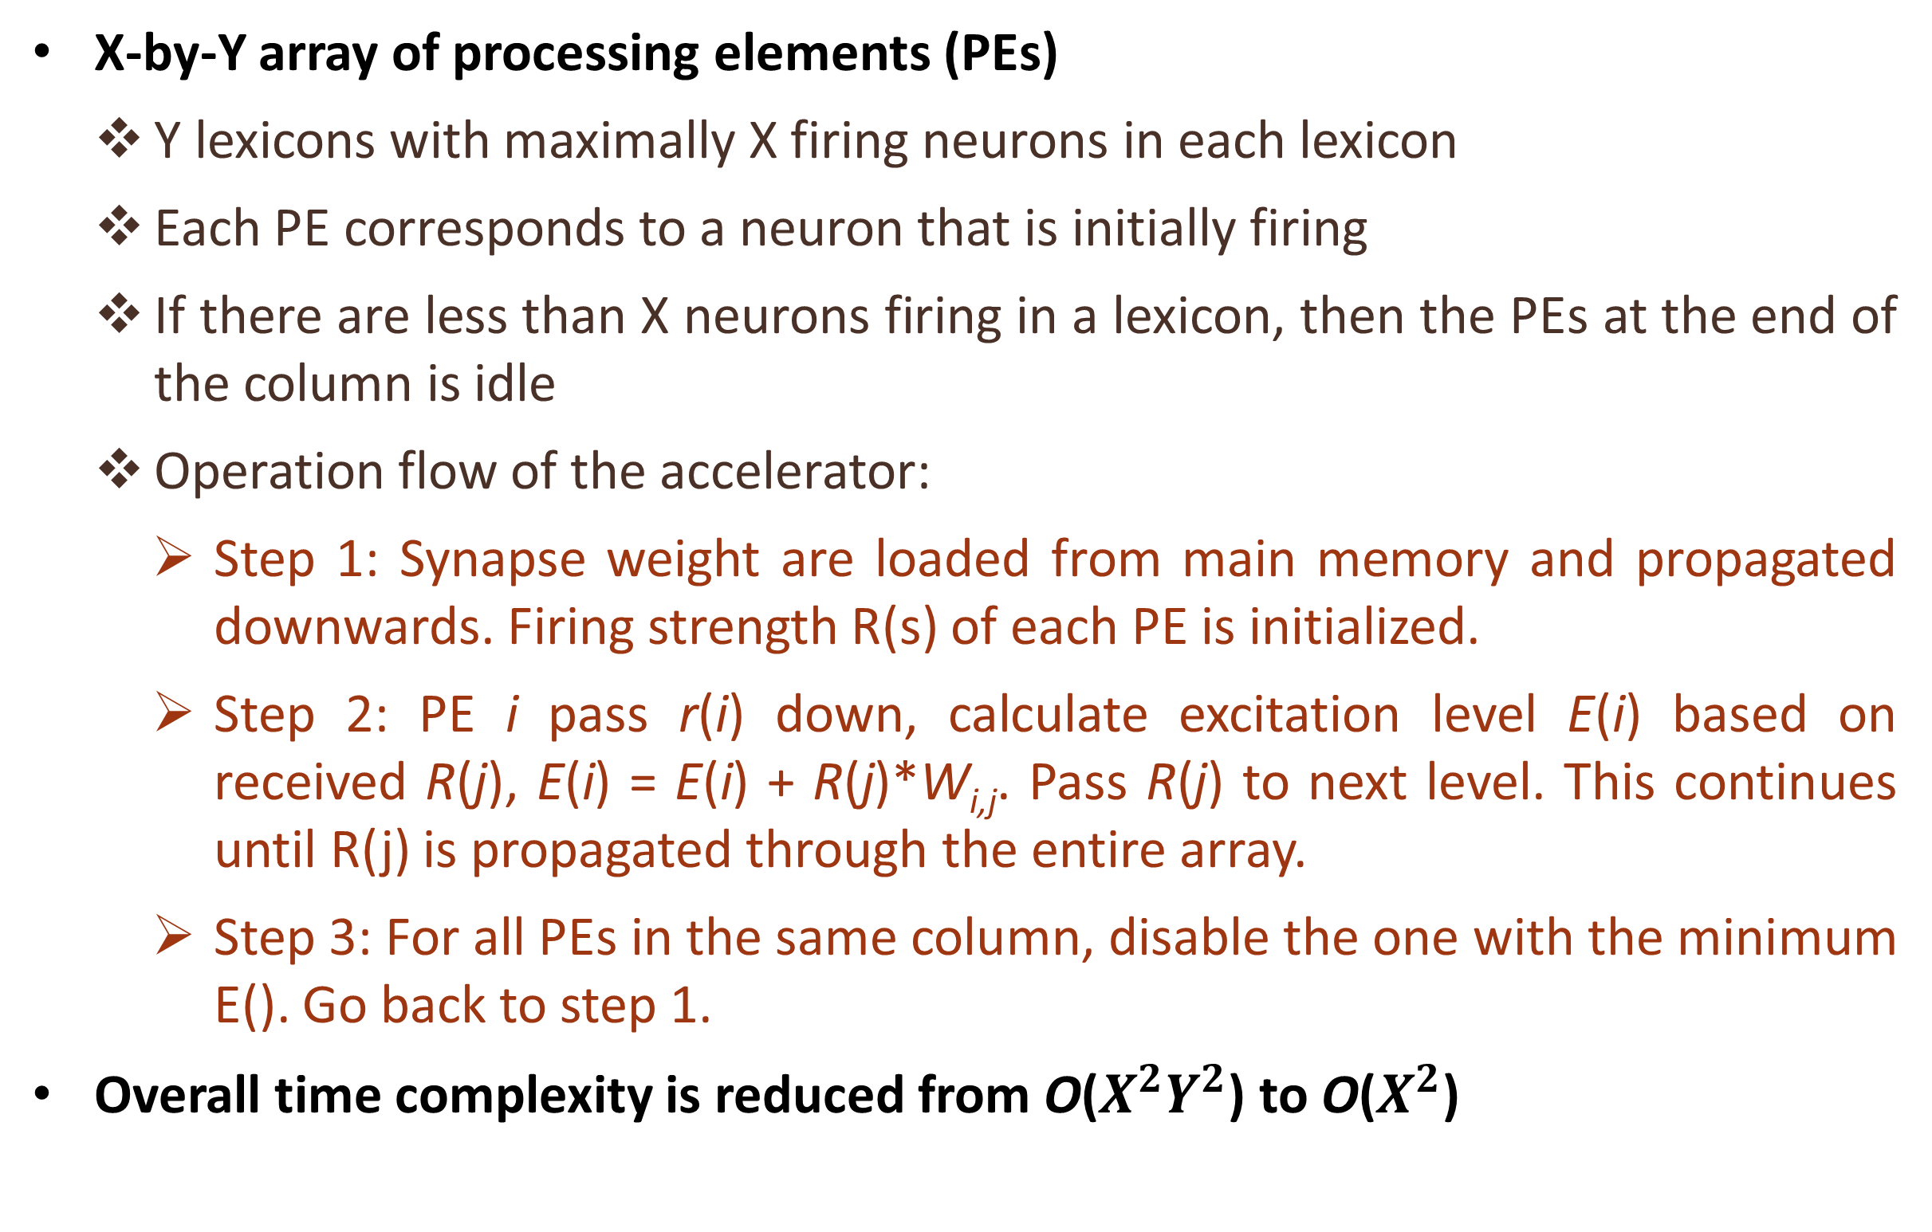
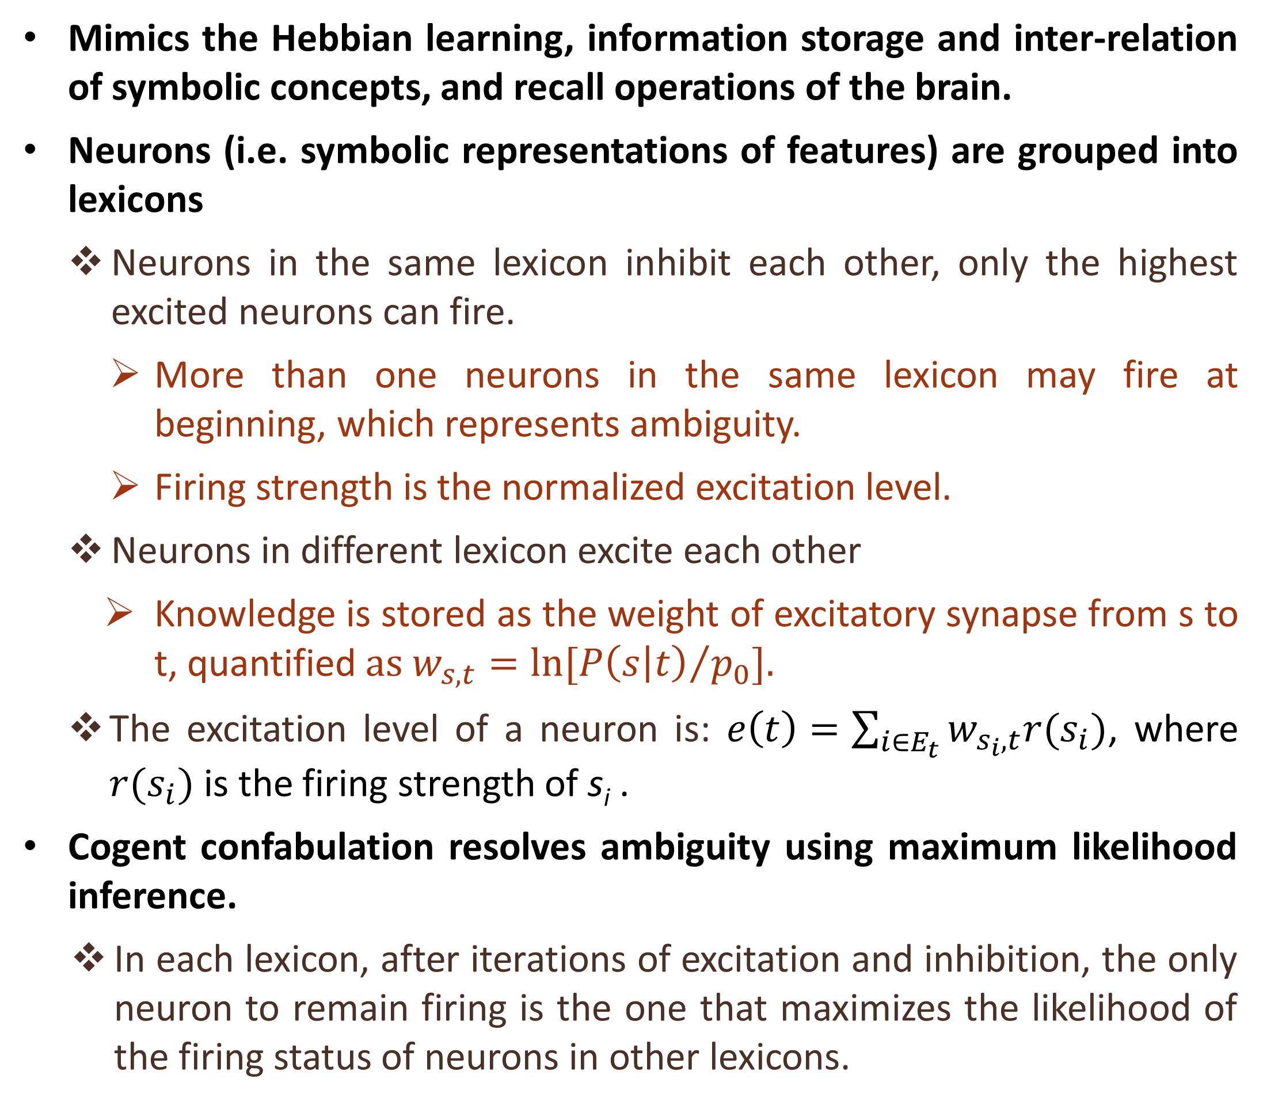
Brain Inspired Information Association on Hardware
Khadeer Ahmed, Wei Liu, Qinru Qiu
Dept. of Electrical & Computer Engineering, Syracuse University, Syracuse, NY 13244 USA
{khahmed, wliu46, qiqiu}@syr.edu
Human Sensory Information Processing
Cogent Confabulation
Hardware Acceleration of Cogent Confabulation
Human sensory information processing is a multi-level process
  Primary sensory cortex detects a specific input (i.e. contour, color, or pitch, etc.)
  Association cortex combines information from the primary sensory cortex to produce perception
  Higher order association combines information from several sensory association areas
Mimics the Hebbian learning, information storage and inter-relation of symbolic concepts, and recall operations of the brain.
Neurons (i.e. symbolic representations of features) are grouped into lexicons
  Neurons in the same lexicon inhibit each other, only the highest excited neurons can fire.
    More than one neurons in the same lexicon may fire at beginning, which represents ambiguity.
    Firing strength is the normalized excitation level.
  Neurons in different lexicon excite each other
    Knowledge is stored as the weight of excitatory synapse from s to t, quantified$as w_{s,t}=ln[{P\left(s | t\right)}/{p_{0}}].$
  The excitation level of a neuron is: $e\left(t\right)=\sum_{i∈E_{t}}{w_{s_{i},t}r(s_{i})}$, where $r(s_{i})$ is the firing strength of s_{i} .
Cogent confabulation resolves ambiguity using maximum likelihood inference.
  In each lexicon, after iterations of excitation and inhibition, the only neuron to remain firing is the one that maximizes the likelihood of the firing status of neurons in other lexicons.
Crossbar data
Processing Element
Weight Store
Serial
Multiply
Accumulate
Crossbar Data
Shift register
Serial
Multiply
Accumulate
Serial
Multiply
Accumulate
PE
PE
PE
weights
Excitation
Adders
PE
PE
PE
Excitation Value
<
<
<
PE
PE
PE
Shift
Shift
Shift
ID
Value
ID
Value
ID
Value
Max Element Picker
Brain Inspired Cognitive Architecture
X-by-Y array of processing elements (PEs)
  Y lexicons with maximally X firing neurons in each lexicon
  Each PE corresponds to a neuron that is initially firing
  If there are less than X neurons firing in a lexicon, then the PEs at the end of the column is idle
  Operation flow of the accelerator:
    Step 1: Synapse weight are loaded from main memory and propagated downwards. Firing strength R(s) of each PE is initialized.
    Step 2: PE i pass r(i) down, calculate excitation level E(i) based on received R(j), E(i) = E(i) + R(j)*W_{i,j}. Pass R(j) to next level. This continues until R(j) is propagated through the entire array.
    Step 3: For all PEs in the same column, disable the one with the minimum E(). Go back to step 1.
Overall time complexity is reduced from O($X^{2}Y^{2}$) to O($X^{2}$)
Training patterns
Frequency
20/100
L₅
L₆
20/100
aa
aa
Higher level association
30/100
bc
bc
30/100
cb
cb
Intelligent Text-image Recognition System
L₁
L₂
L₃
L₄
The brain inspired cognitive architecture has been applied to intelligent text-image recognition
  With word-level and sentence-level association, the system has strong noise rejection.
a
a
a
a
b
b
b
b
Lower level association
c
c
c
c
a
b
c
a
b
c
a
b
c
a
b
c
Pattern matching
…but beginning to perceive that the handcuffs were not for me and that the military had so far got….
Pattern matching
Sensory Input
BSB Recognition
Bottom layer performs massive parallel pattern matching (analogues to the primary sensory cortex)
  Each input patch is fed into multiple (independent) pattern matching engines for the comparison of different patterns
  Each pattern matching engine is a Brain-state-in-a-box (BSB), which is an associative memory
    Simple model that allows fuzzy output (i.e. ambiguity)
Upper layer performs information association using maximum likelihood inference (analogues to the sensory association cortex)
  Resolves the ambiguity by enhancing those matching patterns that mutually maximize the observation likelihood of each other.
  Based on cogent confabulation model
…but b??i??in? to p?r?ei?e t??t ?he ?andcuffs ?ere n?? f?r me an? th?t t?e mi?itary ?ad s? fa? g?t ….
Percentage of Occluded letters |  | Great Exp. | Lost World
10% | Word accu. | 95.5% | 97.0%
 | Sentence accu. | 60.2% | 63.8%
20% | Word accu. | 90.5% | 92.7%
 | Sentence accu. | 33.6% | 31.2%
30% | Word accu. | 86.3% | 86.4%
 | Sentence accu. | 23.9% | 20.7%
Association (word level)
Word Level Confabulation
Knowledge
Base (KB)
but | b??i??in? | to | p?r?ei?e | t??t | ?he | ?andcuffs | ?ere | n?? | f?r | me | an? | th?t | t?e | mi?itary | ?ad | s? | fa? | g?t
but | besieging | to | porceite | twit | the | handcuffs | fere | nut | fur | me | any | thit | toe | military | mad | su | fax | gut
 | believing |  | perceive | that | she |  | sere | nun | for |  | ant | that | tie |  | lad | st | fat | got
 | beginning |  | parseile | text |  |  | were | nod | fir |  | ann |  | the |  | had | ss | far | get
 | banishing |  |  | test |  |  | here | not | far |  | and |  | tee |  | gad | so | fan | gat
 | …… |  |  | …. |  |  | … | … |  |  | … |  | … |  | … | … | … | …
Association (sentence level)
Sentence Level Confabulation
Knowledge Base (KB)
…but beginning to perceive that the handcuffs were not for me and that the military had so far got….

